Slide 1




CS Bridge, Lecture 17 Final Project

Slide 2
Now’s the time for you to build something awesome.

Slide 3


Slide 4
Final Project Goals
Build something you are proud of!
Build something you are excited about building
Build something you think of yourself
Build something you can complete by the end of the class
Build something using the concepts you have learned in CS Bridge

Slide 5
Final Project Material
Think about using material we have learned so far in CS Bridge, like:
Graphics
Animation
Mouse (and Keyboard)
Control Flow + Variables
Console Programs
Lists
Dictionaries

Slide 6
Final Project Ideas
Brainstorm any program you want! It could be:
A game (like Breakout)
A significant extension to Breakout or another CS Bridge project
A console program that analyzes data
A graphical simulation
Interactive art
A short film
Mathematical calculations
Or anything else…

Slide 7

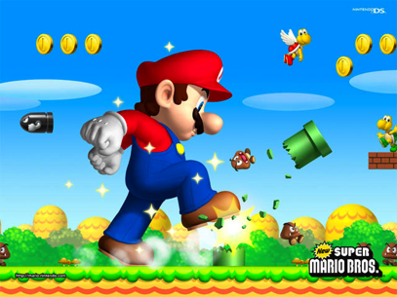

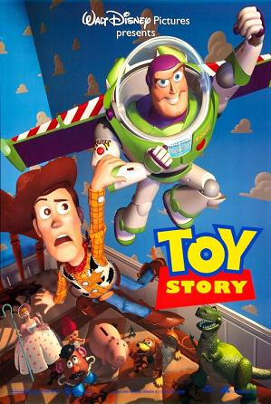
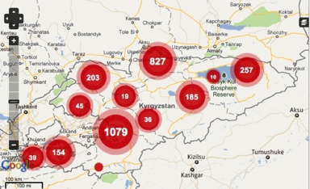
The Joy Of Building

Slide 8
Final Project Timeline
Today: finish Breakout / start brainstorming final project ideas
Monday morning: during lecture, meet your morning SL to discuss your final project ideas and get one approved
Monday evening: work on final project!
Thursday AM submission period: last chance to submit final project

Slide 9
We can’t wait to see what you create!

Slide 10
Python Project
Download the python project from the course website when you are ready to start coding
Some new graphics library updates, including:
Getting the fill/outline color of an object
Setting objects to be hidden
Delete all objects from the canvas
Get a list of all objects on the canvas
https://online.csbridge.org/en/resources/api-docs/graphics.html

Slide 11

Closest Thing To Magic

Slide 12
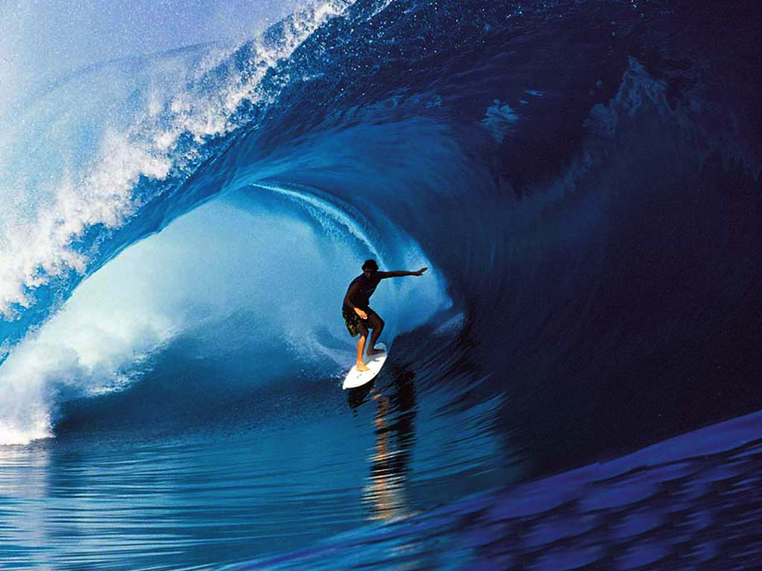
Learn By Doing

